Slide 1

STATE OF TEXAS v
BYRON RUE

Slide 2
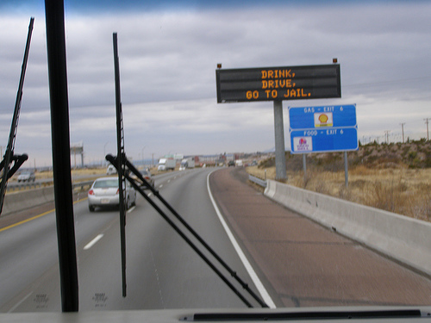
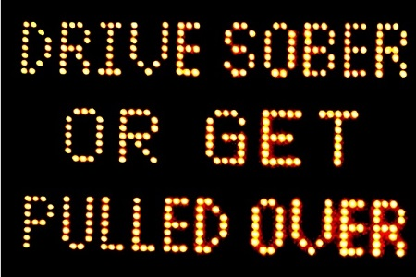
DRINKING
Drink, Drive, Go to Jail
Drive Sober or Get Pulled Over
Going Out Tonight, So Are We

Slide 3

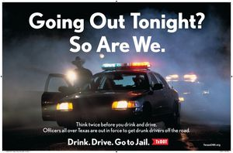

Slide 4
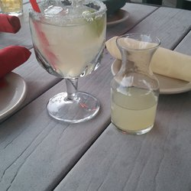
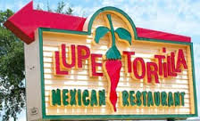
NOT ILLEGAL TO DRINK AND THEN DRIVE; as long as you’re NOT intoxicated

Slide 5
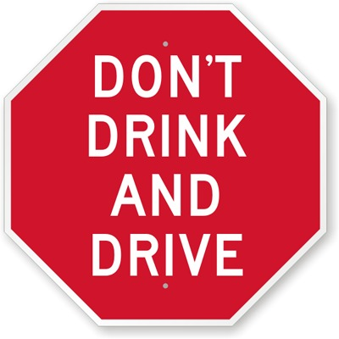
BUT, WHO STILL SAYS…

Slide 6
DRINKING PATTERNS
A. REGULARLY
B. OCCASIONALLY
C. RARELY
D. NEVER
E. NOT ANY MORE

Slide 7
ALCOHOL
MEMBER OF MADD
MEMBER OF AA
STRONGLY AGREE WITH “NO REFUSAL” WEEKENDS
ALCOHOLISM IN FAMILY
NO ALCOHOL IN HOME
INJURED/VICTIM OF ALCOHOL RELATED CRIME

Slide 8


RELATED TO?

Slide 9
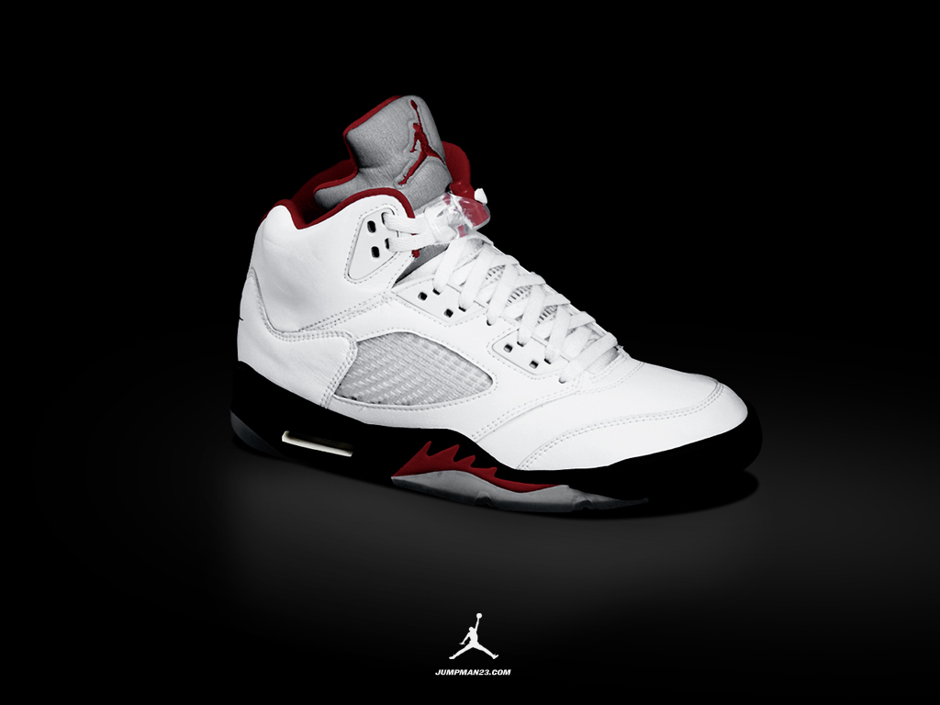
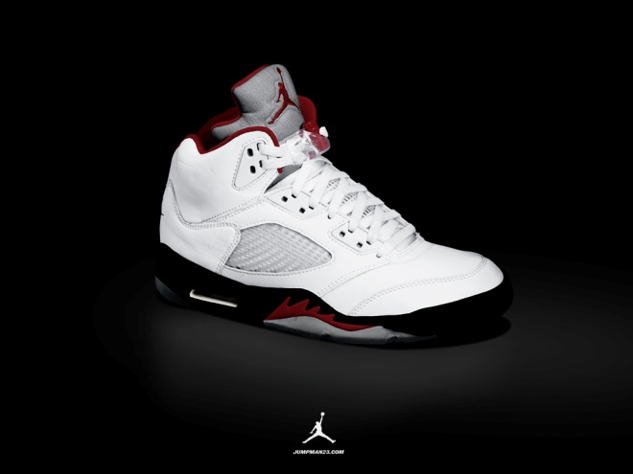
NORMAL v AVERAGE
SIZE 6 SIZE 10

Slide 10
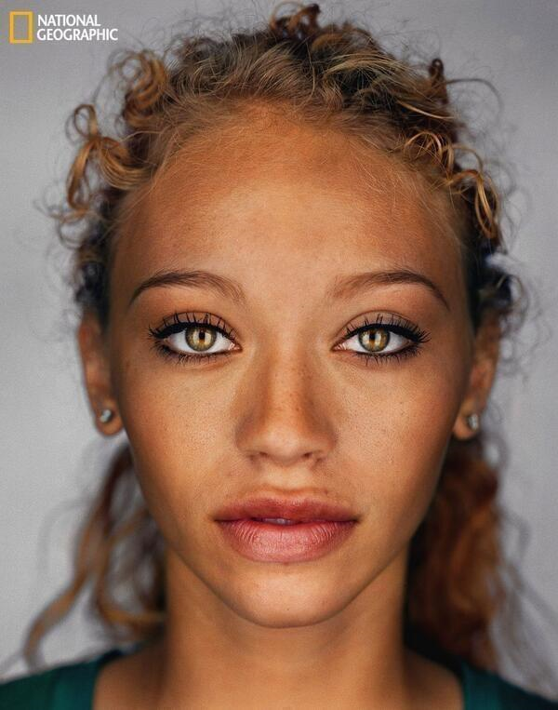

Slide 11
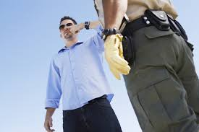
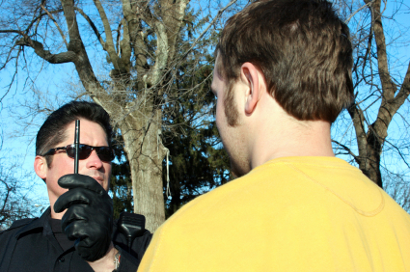
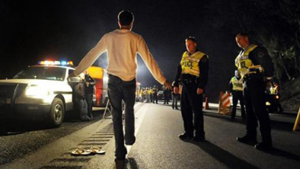

Slide 12
INSTRUCTIONS
How Many Times?
Practice?
Grading System?
Looking For?
Speed?

Slide 13
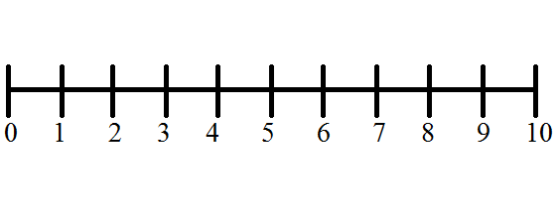
PRESUMPTION OF INNOCENCE
INNOCENT GUILTY

Slide 14
ASSUME
v.
PRESUME

Slide 15
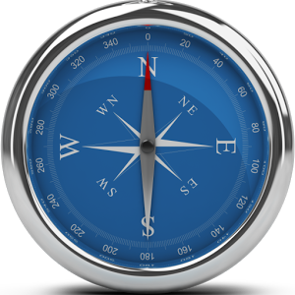

PRESUMPTION OF INNOCENCE

Slide 16
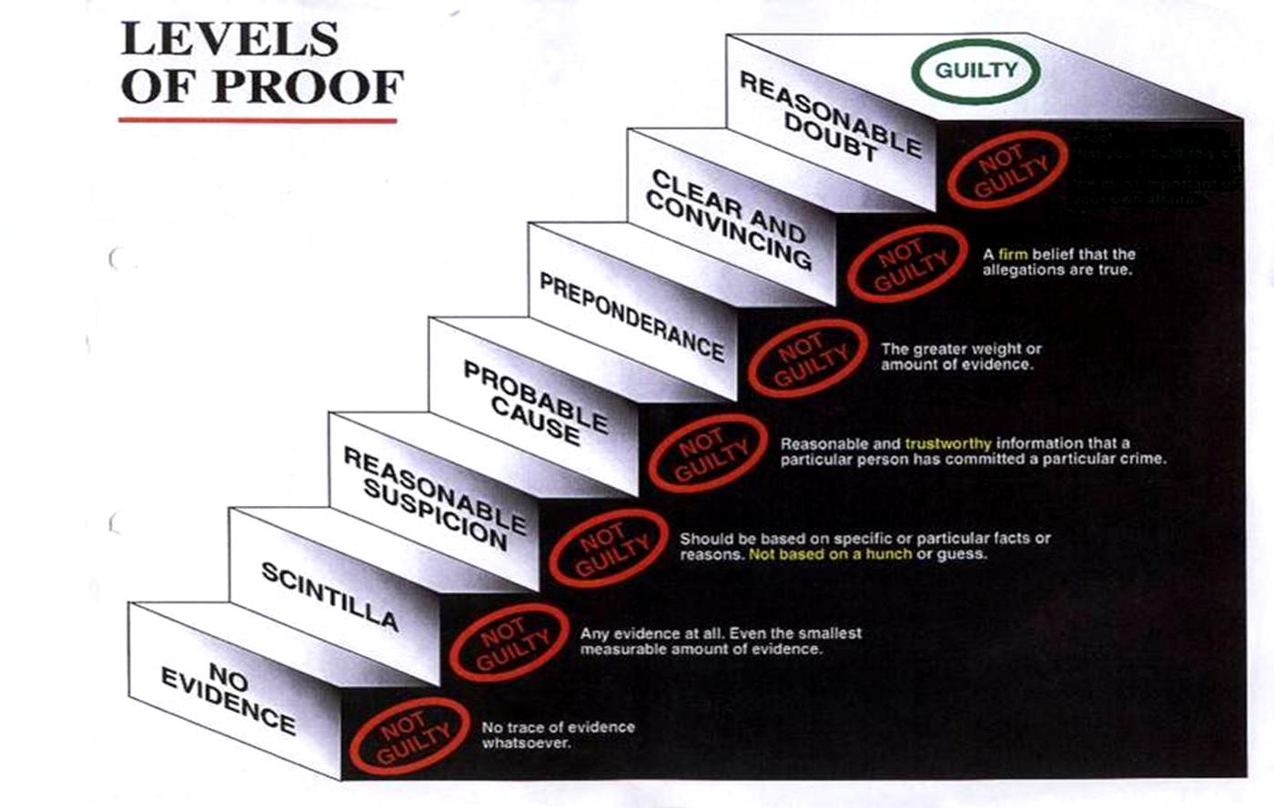

Slide 17
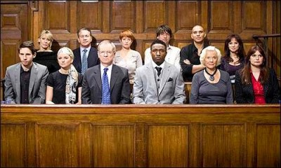
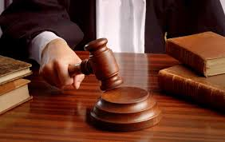
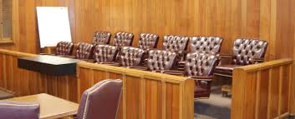
JURY SERVICE

Slide 18
THANK YOU

